Slide 1
Lecture 5-2
Logistic (regression) classification:
cost function & gradient descent
Sung Kim <hunkim+mr@gmail.com>
http://hunkim.github.io/ml/

Slide 2


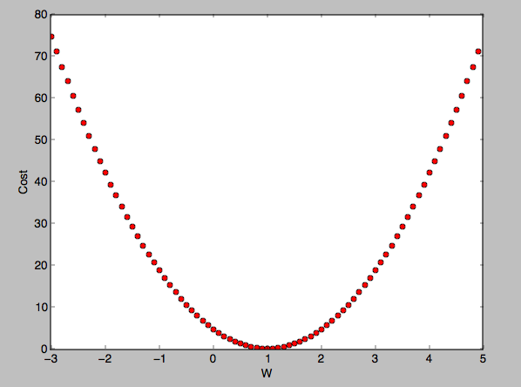
Cost
when

Slide 3

Cost function

Slide 4


New cost function for logistic
cost
c
c

Slide 5
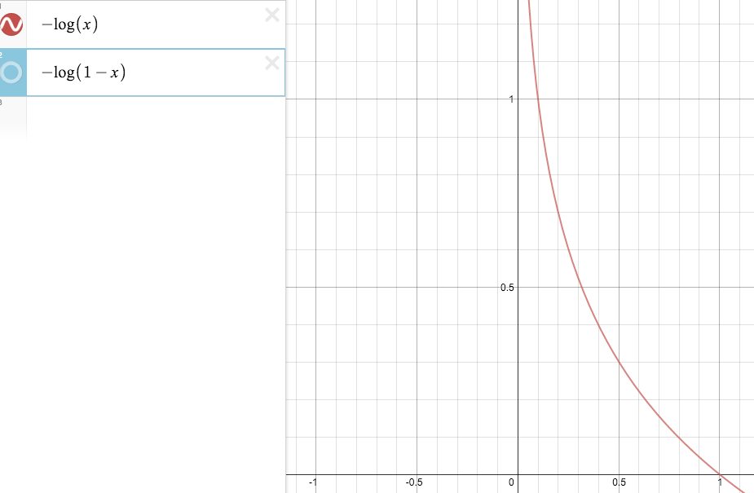
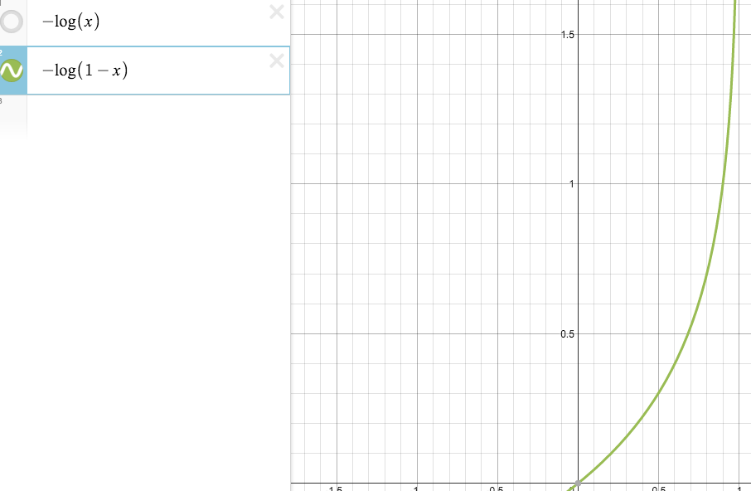
understanding cost function
c

Slide 6
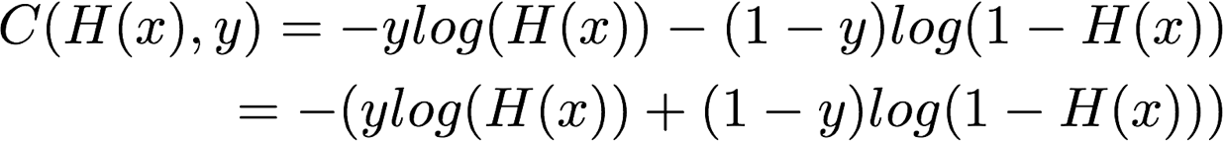
Cost function
cost
c
c
Notes:
Latex: C(H(x),y)=-ylog(H(x))-(1-y)log(1-H(x))
\\ = - (ylog(H(x))+(1-y)log(1-H(x)))

Slide 7

Minimize cost - Gradient descent algorithm
cost

Slide 8
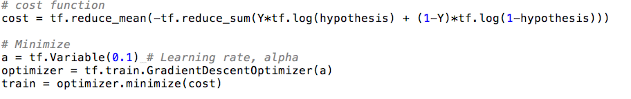
Gradient descent algorithm
cost

Slide 9

Next
Multinomial classification (Softmax)

